Slide 1




Smart Agriculture Advisory System Using Machine Learning
Agro-Meteorology Based Crop Planning System
Submitted to: Course Teacher, EAI-421: Applications of AI & ML in Agriculture
Presented by: Abhishek Gowda V (AMB2009) | Shashank Gowda (AMB2229) | Vikas Gowda T N (AMB2297)
Affiliation: IV BSc. (Hons') Agriculture, Module - 3, College of Agriculture, GKVK, Bengaluru - 560065
Academic Year: 2025–26

Slide 2

Index
Introduction
Problem Statement
Motivation
Objectives of the Project
Dataset Overview
Methodology / Approach
Tools and Technologies Used
Results
Discussion / Analysis
Conclusion and Future Work
References / Acknowledgements

Slide 3
Introduction
●Agriculture contributes ~18% to India's GDP and supports over 58% of the rural population.
●Smallholder farmers face chronic challenges in decision-making, exacerbated by erratic monsoons, rising temperatures, and climate variability.
●The Smart Agriculture Advisory System (SAAS) addresses this by using machine learning to predict soil moisture strictly from observable weather inputs.
●By combining predicted soil moisture with temperature data, the system recommends suitable crops tailored to Karnataka’s agro-climatic conditions.
●The system accommodates both technical and non-technical users via dual input modes (descriptive vs. numeric).

Slide 4
Problem Statement
●Absence of Real-Time Support: Crop selection relies on traditional calendars rather than real-time soil/weather data, leading to mismatched crops and avoidable yield losses.
●Poor Soil Moisture Estimation: Soil moisture is critical, yet sensors are inaccessible at the farm level, and manual estimation is highly inaccurate.
●Climate Variability: Increased droughts and unpredictable rainfall render traditional monsoon-onset calendars disproportionately risky.
●Literacy Barriers: Existing tech tools lack local-language or simple descriptive interfaces, creating a barrier for primary stakeholders.

Slide 5




Motivation
National Food Security
Doubling farmers' income requires an urgent upgrade in technology-enabled, farm-level advisory infrastructure.
Climate-Smart Imperative
Changing global precipitation patterns demand a transition from static calendars to dynamic, data-driven approaches.
AI Democratisation
Affordable computing and open-source libraries allow the deployment of low-cost advisory systems on basic hardware.
Local Relevance
Acts as an excellent testbed for Karnataka's diverse agro-climatic zones and major crops like Ragi, Maize, and Paddy.

Slide 6
Objectives of the Project
Main Objective
Develop a machine learning–based advisory system that predicts soil moisture from weather parameters and recommends crops for improved decision-making.
Model Optimization
Evaluate baseline algorithms (Decision Tree, Random Forest) against Multiple Linear Regression to achieve highest accuracy.
Accessibility
Design dual-mode input interfaces: a farmer-friendly descriptive mode and a numeric precision mode for advanced users.
Actionable Output
Generate real-time field advisories (e.g., irrigation needs, drainage, disease risk alerts) alongside tailored crop recommendations.

Slide 7
Dataset Overview
Source Data
Agronomic field observations representative of Karnataka's major Kharif and Rabi cropping zones.
Target Variable
Soil Moisture (%) — Volumetric water content in soil, predicted strictly from weather inputs.
5 Input Features
● Rainfall (mm) & Temp (°C)
● Humidity (%) & Wind (km/h)
● Day Length (hours)
Pre-processing: Cleaned column formatting; dropped rows with missing (NaN) values.
Crop Database: Rice, Ragi, Maize, Red Gram, Groundnut

Slide 8
Methodology & Workflow
Step 1 — Data Ingestion
Ingest CSV/Excel, normalise columns, and handle missing values.
Step 2 — Train-Test Split
Divide data into 80% training and 20% testing sets using Scikit-learn.
Step 3 — Exploratory Analysis
Generate feature correlation heatmaps to understand meteorological relationships.
Step 4 — Algorithm Comparison
Train baseline Decision Tree and Random Forest regressors.
Step 5 — Model Deployment
Implement Multiple Linear Regression model for real-time field predictions.
Step 6 — Recommendation
Deterministic rule-based engine for crop selection and threshold-based alerts.

Slide 9

Tools & Technologies Used
Programming Language
Python — used for building the lightweight, scalable advisory system.
Data Manipulation Libraries
Pandas and NumPy for tabular record handling, dataset formatting, and numerical operations.
Machine Learning Framework
Scikit-learn for train_test_split, regression algorithms (Multiple Linear, Decision Tree, Random Forest), and error metrics.
Visualization Tools
Used to map model evaluations and error metrics via generated graphs and bar charts.

Slide 10
Results: Model Performance
Model
R²
MAE (%)
RMSE (%)
Decision Tree
0.8700
5.31%
6.84%
Random Forest
0.9400
4.21%
4.78%
Multiple Linear Regression
0.9600
2.85%
3.96%
Outcome: The MLR algorithm significantly outperformed the complex ensemble methods in predictive accuracy and error reduction.

Slide 11
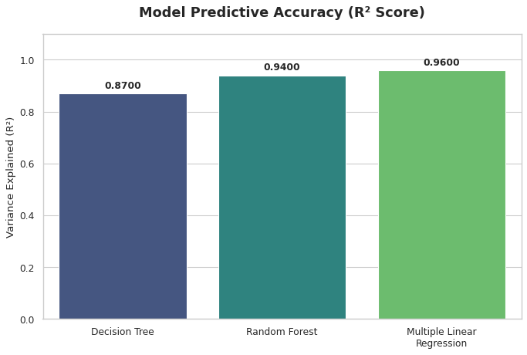
R² Comparison for All Three Models

Slide 12
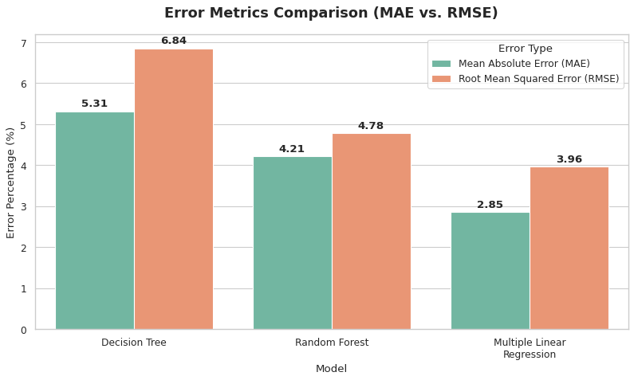
Error Metrics Comparison

Slide 13
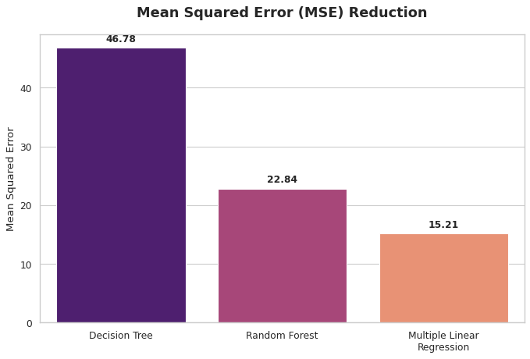
MSE Comparison

Slide 14
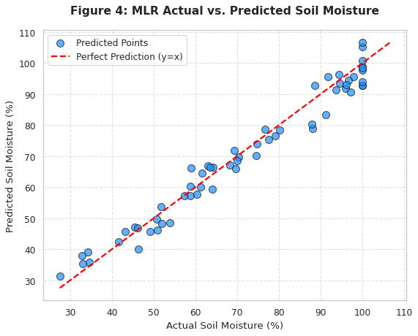
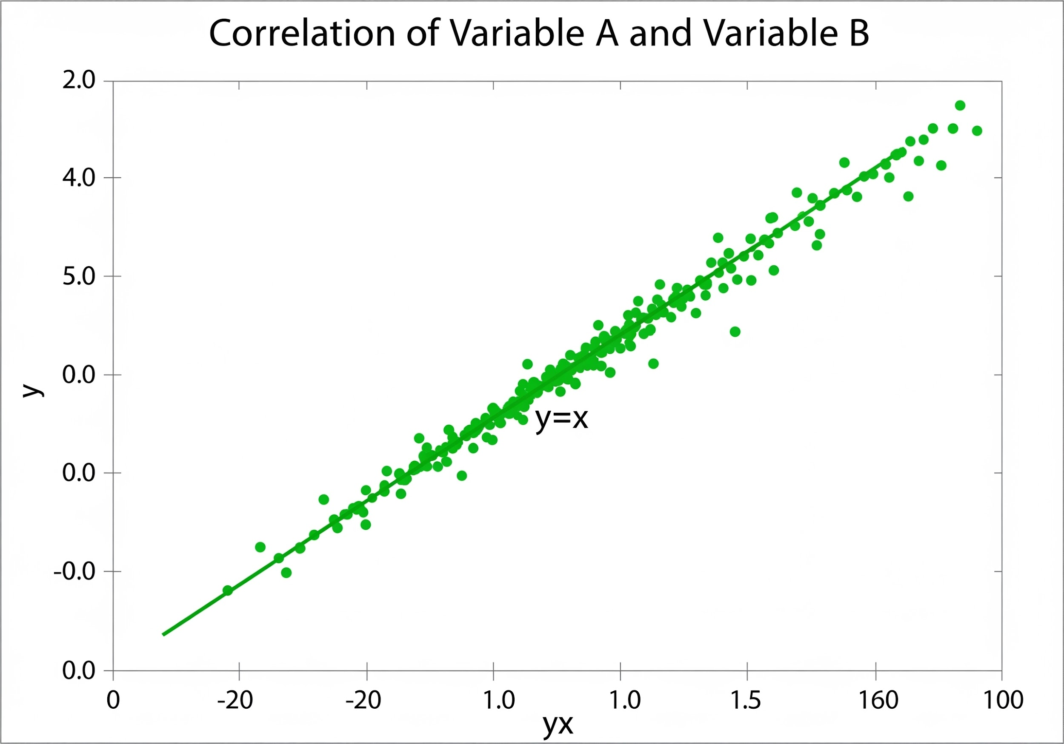
Results: Predictive Accuracy
Sample System Output
Input Parameters:
• Rain: 10mm
• Temp: 32°C
Prediction:
• Moisture: 28.3%
Advisory:
Irrigate & plant Red gram / Groundnut
Scatter Plot Analysis: Densely clustered points along y=x trajectory (R²: 0.96) confirm high variance capture.

Slide 15
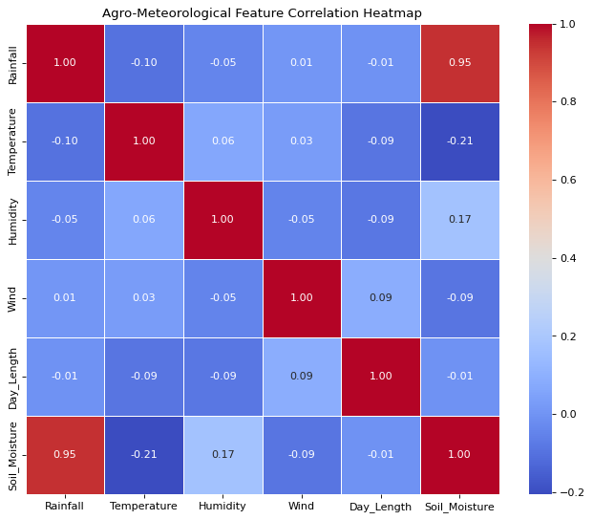
Agro-Meteorological Feature Correlation Matrix

Slide 16
Discussion & Analysis
Model Performance
An R² score of 0.96 proves that the MLR model is highly capable of predicting soil moisture accurately for field-deployment.
Interpretability
Transparent recommendation engine allows farmers to verify thresholds directly, building user trust.
Input Mode Effectiveness
"Field Observation" mode introduces minor acceptable error (±5%), overcoming literacy barriers while preserving accuracy.
System Limitations
Lacks soil pH/topography parameters, 7-day forecasting, and faces seasonal errors due to fixed day-length.

Slide 17

Conclusion and Future Work
Conclusion
Future Work
• High Accuracy System
Successfully developed a low-cost Python system with R² = 0.96 using Multiple Linear Regression.
• Inclusive Accessibility
Dual-input modes bridge the gap for both technical and non-technical farmers.
Expansion: Database growth to 30+ crops across Karnataka.
Integration: IMD Weather APIs for 7-day forecasting and IoT telemetry.
Deployment: Kannada Android interface and LSTM deep learning research.

Slide 18
References & Acknowledgements
References
Acknowledgements
• Breiman, L. (2001). Random Forests. Machine Learning, 45(1), 5–32.
• IMD. (2024). Annual Rainfall Data Reports. India Meteorological Department.
• ICAR. (2024). Handbook of Agriculture (7th Edition).
• Pedregosa, F., et al. (2021). Scikit-learn: Machine Learning in Python.
Sincere gratitude to the Course Teacher of EAI-421, University of Agricultural Sciences, Bengaluru (UAS-B) for conceptual framework and mentorship.
Special thanks to the College of Agriculture, UAS-B for providing the necessary resources and environment for this research.

